Slide 1
TalkingData Mobile User Demographics
Get to know millions of mobile device users

Slide 2
Business Case
80% of the Top 50 app developers in China utilize TalkingData
Industry giants such as China Merchants Banks, CitiBank, Ping An Group also rely on TalkingData’s enterprise Big Data solution
To build a model predicting users’ demographic characteristics based on their app usage, geolocation, and mobile device properties
End-user: Developers and brand advertisers around the world. They can pursue data-driven marketing efforts which are relevant to their users and catered to their preferences.

Slide 3
File descriptions
The Data is collected from TalkingData SDK integrated within mobile apps TalkingData serves under the service term between TalkingData and mobile app developers.
gender_age_train.csv, gender_age_test.csv - the training and test set
group: this is the target variable you are going to predict
events.csv, app_events.csv - when a user uses TalkingData SDK, the event gets logged in this data. Each event has an event id, location (lat/long), and the event corresponds to a list of apps in app_events.
timestamp: when the user is using an app with TalkingData SDK
app_labels.csv - apps and their labels, the label_id's can be used to join with label_categories
label_categories.csv - apps' labels and their categories in text
phone_brand_device_model.csv - device ids, brand, and models

Slide 4
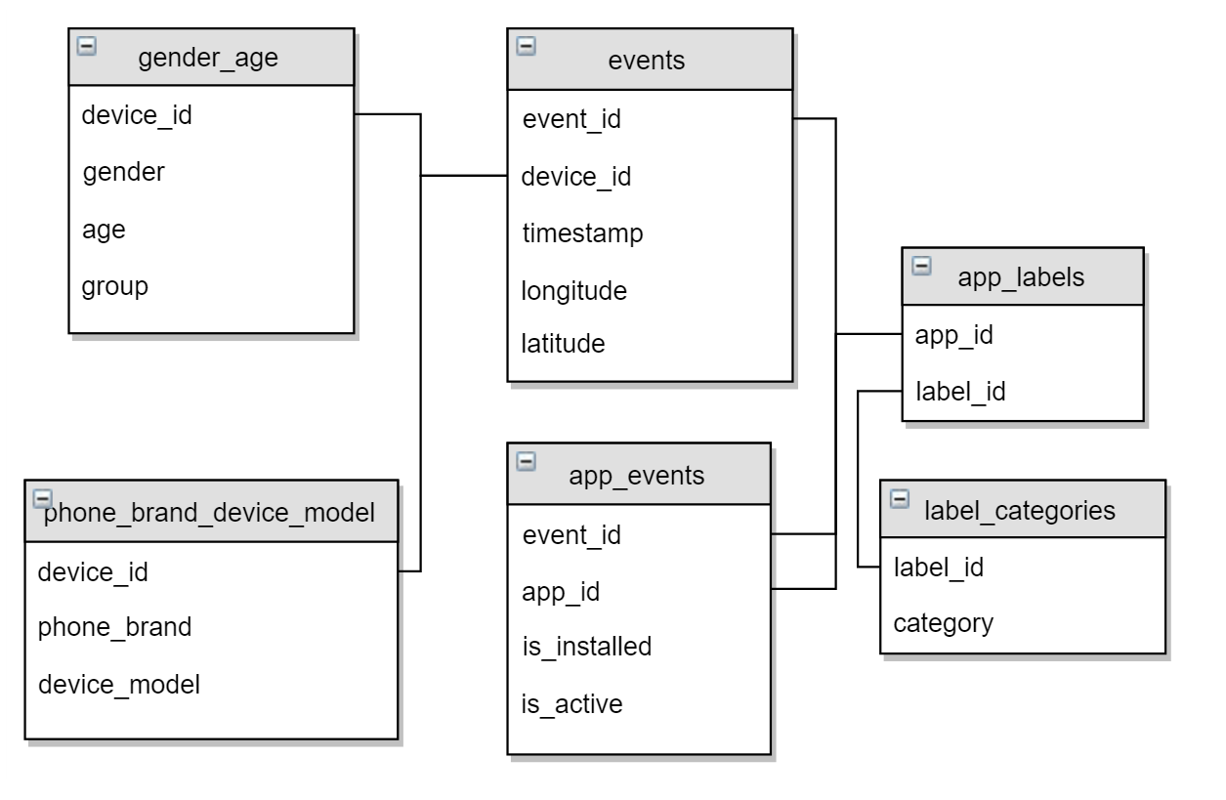
Data Schema

